Slide 1
Experimental design and statistical analysis
Michela Traglia and Reuben Thomas
Bioinformatics Core, GIDB
Gladstone Institutes
November 30, 2021

Slide 2
Introductions
Michela Traglia
Statistician III
Reuben Thomas
Associate Core Director

Slide 3
Statistics is defined as
the science of collecting, analyzing, and drawing conclusions from data

Slide 4
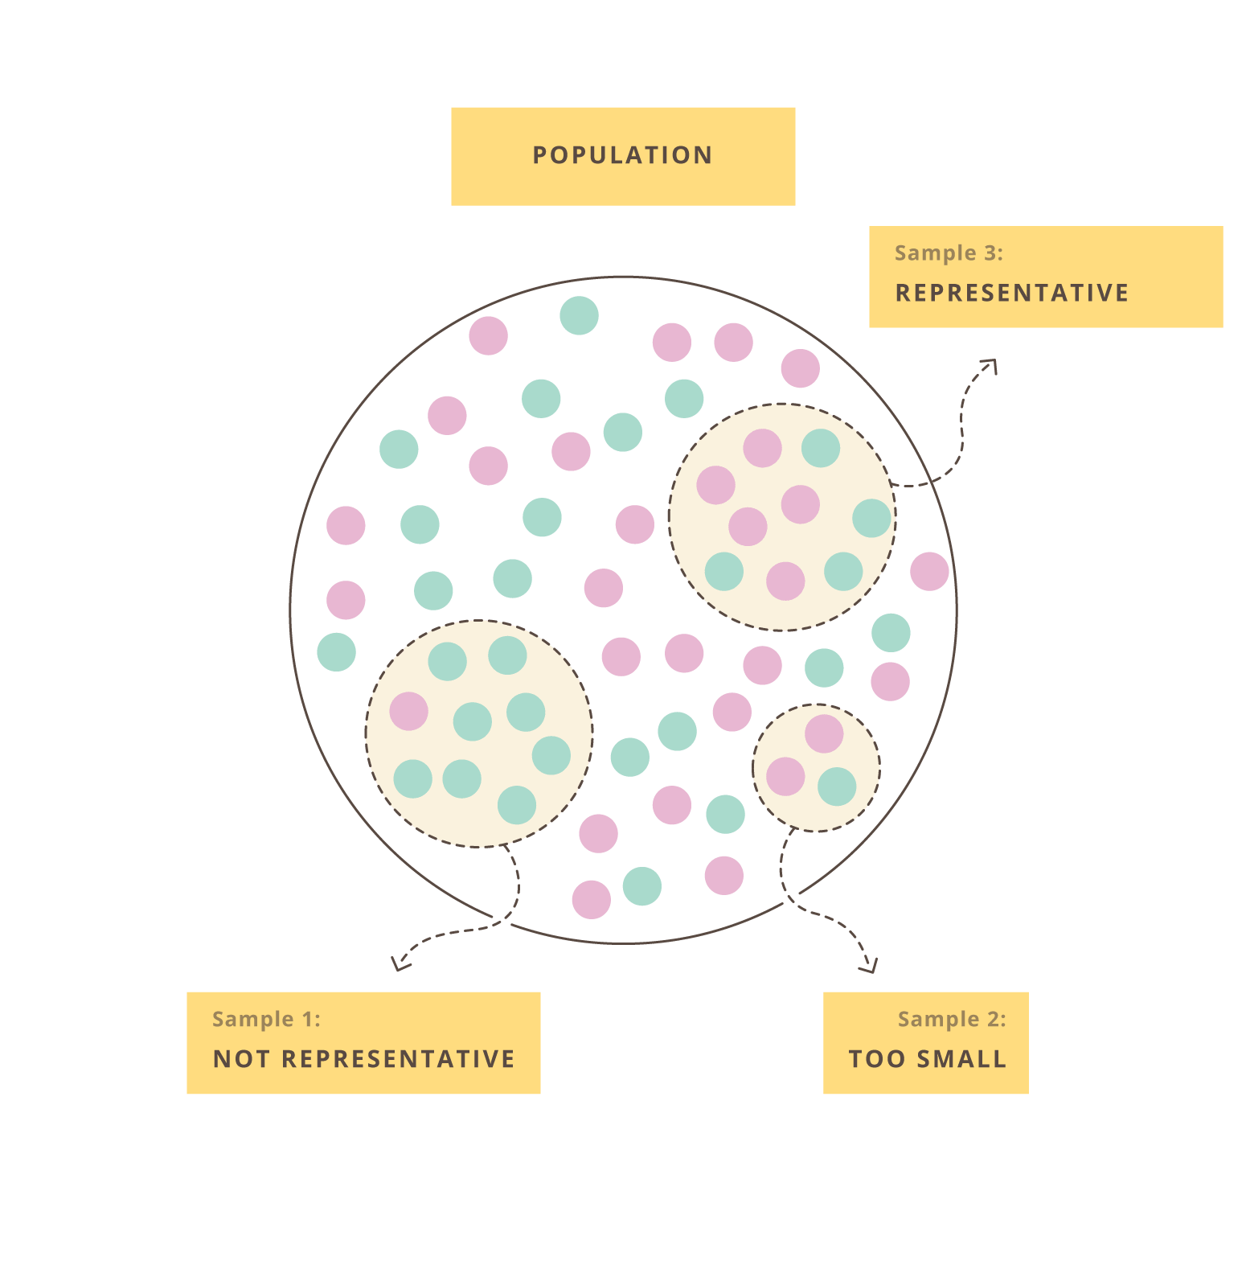
Generalization
Empirical data are noisy
Resources are limited

Slide 5
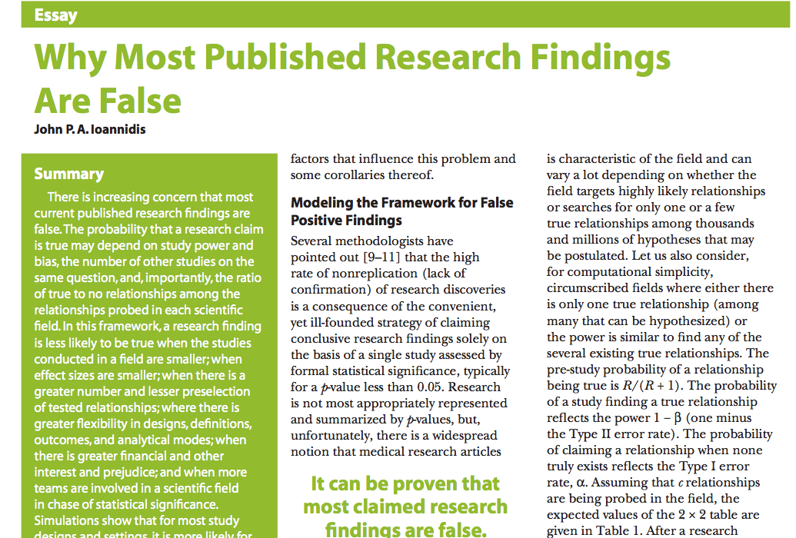
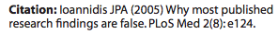

Slide 6
Thanks: Kevin Mullane
Director, Corporate Liaison & Ventures
Corporate Ventures and Translation
Gladstone Institutes
https://gladstone.org/events?series=responsible-conduct-of-research
https://rcr.ucsf.edu/

Slide 7
The purpose of the experimental design is to
plan the experiment in a way that makes sure
it can answer your biological question
Old journalists requirements of 5 Ws and 1 H
who, what, when, where, why and how

Slide 8
Motivation of the workshop
Accessible statistical tools allow researcher to easily perform analyses
How the program work and which setting to use?
How to interpret the results?
Hard to get defensible conclusions
Before the statistical analysis, fundamental is to plan the experimental design
Understand and critically evaluate scientific publications

Slide 9
Goals of this workshop
Introduce basic concepts underpinning experimental design
Learn how to think critically about the data you want to generate and use to make claims about
Overview of statistical tests and concepts
Basic level course - No prerequisites
Please feel free to interrupt with questions, speak up or use the chat!

Slide 10
Real data is complex
This workshop provides an introduction to typical experimental design and statistics.
Experimental design can be very complicated
Real data might need additional analyses choices.
Some analysis choices need experience.
Consult with the Gladstone Bioinformatics core for such scenarios and data.

Slide 11
Outline
Experimental design principles
Types of analytical studies
Independent variable / response variable
Target population and generalization
Statistical principles
Experiment: Assess differences between gene expression at two developmental stages
Aggregation and inter-comparison
P-value and multiple test correction
Biological and technical replicates
Power and sample size
Overview statistical tests based on response and predictor
Confounding factors
Good vs bad experimental design

Slide 12
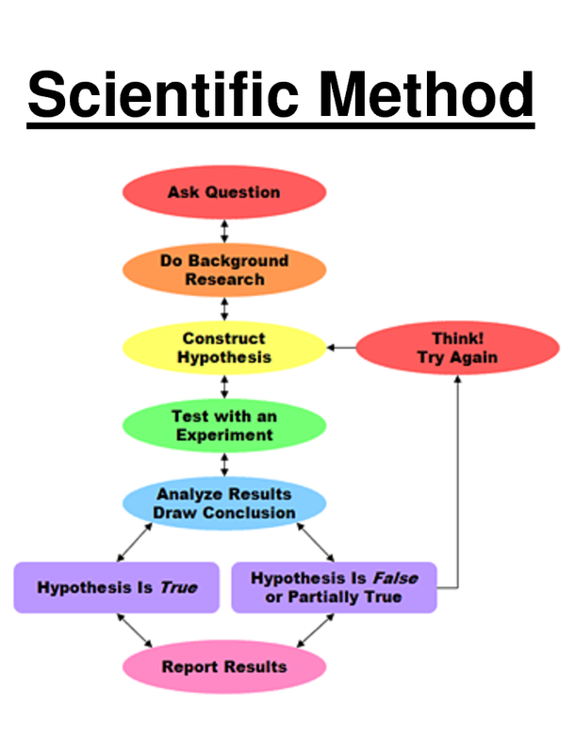
Statistical experimental designs
The scientific method consists of iterative application of the following steps:
observing of the state of nature
(2) hypothesizing the mechanism for what has been observed
(3) collecting data
(4) analyzing the data to confirm or reject the hypothesis
Statistical experimental designs provide a plan for collecting data in a way that they can be analyzed statistically to corroborate the conjecture in question.

Slide 13
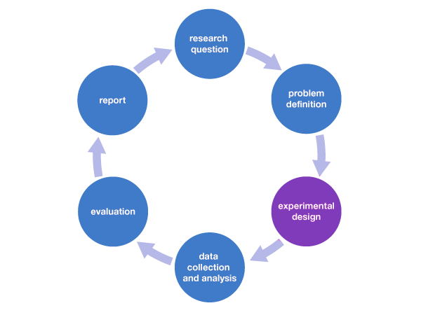

Slide 14
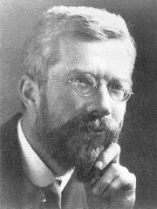
Ronald Fisher
Overcome the large amount of variation in agricultural and biological experiments that often confused the results
This motivated him to find experimental techniques that could
eliminate as much of the natural variation as possible
prevent unremoved variation from confusing or biasing the effects being tested
detect cause and effect with the minimal amount of experimental effort necessary - time consuming and costly
1920 CE, Design of Experiments

Slide 15
Problem definition and research question
A specific issue, contradiction between two or more perspectives, or a gap in knowledge that you will aim to address in your research.
What is a (or the) scientific question that you are currently working on?

Slide 16
Analytical studies – define objectives
Observational studies
Experimental studies
Researchers don’t assign choices
Observing what is already happening
No establishing cause-effect
Ex. Case-controls, cohort
Researchers manipulate factors
Create a treatment and compare the response
Changes cause an effect
Ex.Clinical trials
Why is the experiment to be performed?
Aim is to classify sources of variability? Or to study cause and effect relationship?

Slide 17



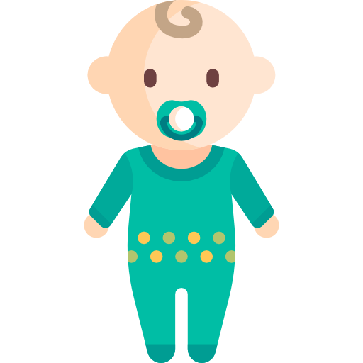

Chemical pollutants during pregnancy contributing to autism in children
Problem definition and research question
CONTROL
ASD CASE
Lyall et al, Environ Health Perspect 2017

Slide 18
Poll
We want to study a potential association between pollutants measured in a cohort of pregnant women and autism diagnosed in their children (age 2-3).
Which kind of study are you dealing with?
1. Observational study
2. Experimental study

Slide 19
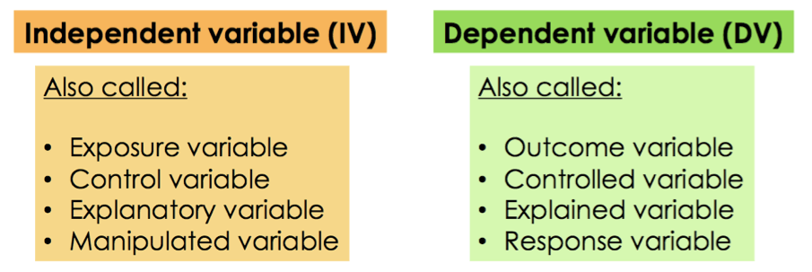
Independent variable and Response
Risk factors
Genotype
X
Disease
Gene expression
Y
In an experiment, you manipulate an independent variable to study its effects on a dependent variable (response)
Image source: by Hannah Bonville

Slide 20
Experimental units
Experimental materials to which we apply treatment and on which we make observations
Animal or human subject
Raw material for some processing operation
Condition that exist at a point in time or trial?
Notes:
Experimental error: uncontrolled variation in the experiment
Identify the experimental units and the source of variation

Slide 21
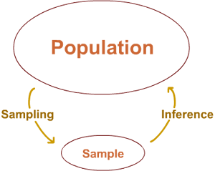
Target population - generalization
All subjects/units that we want base our claims/conclusions on
The cardiac tissue of all mice at embryonic stage E9.5
All children below 5 years old who are diagnosed with autism
All mother that were pregnant in a geographical area
Data is expensive
Studying of the sample ➔ Conclusion on the population
What are the conclusions you would like to draw from the results of your experiment?

Slide 22
Biological aspect to consider
Does the samples reflect the hypothesis/question?
What else is known beforehand on the topic? (e.g Expression levels on known interesting genes available?)
What samples are available? More samples at a later time?
Does the cell type express the genes of interest?
All biopsies should be taken from the same part of the tissue!
Do you have enough RNA from each sample or is pooling of samples required?

Slide 23
Outline
Experimental design principles
Types of analytical studies
Independent variable / response variable
Target population and generalization
Statistical principles
Experiment: Assess differences between gene expression at two developmental stages
Aggregation and inter-comparison
P-value and multiple test correction
Biological and technical replicates
Power and sample size
Overview statistical tests based on response and predictor
Confounding factors
Good vs bad experimental design

Slide 24
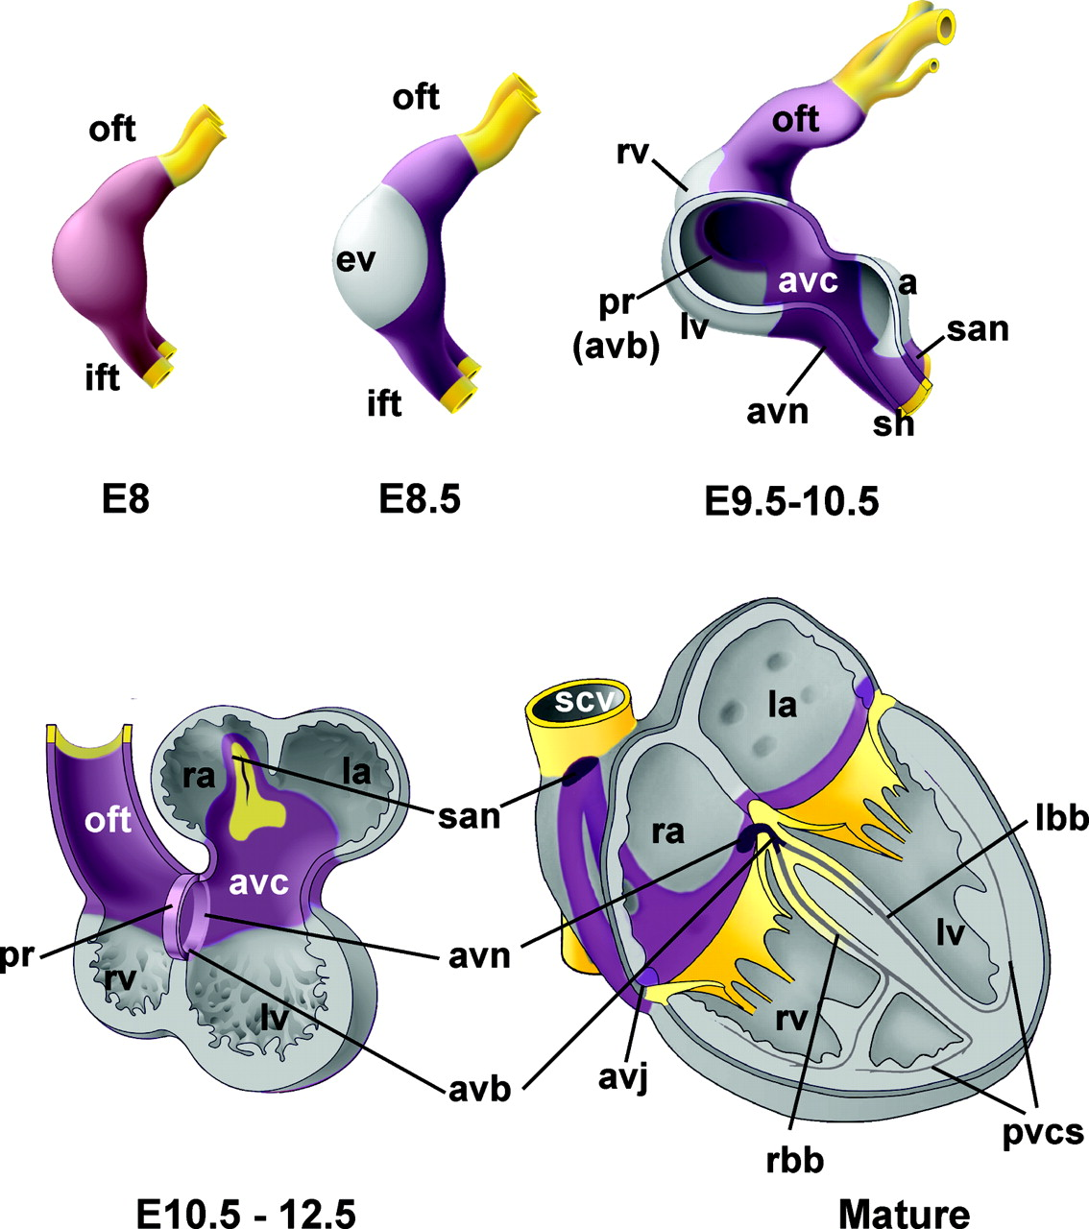
Problem definition and research question
Gene controlling developing heart
https://www.ahajournals.org/doi/epub/10.1161/CIRCEP.108.829341

Slide 25
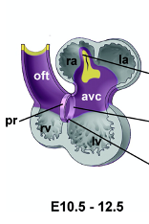
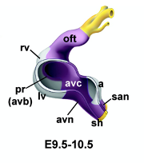
Is gene differentially expressed between the two developmental time-points?

Slide 26
Aggregation: one number to capture an entire distribution

Slide 27
Information on aggregate measure: rate of gain decreases with increasing sample size

Slide 28
Inter-comparison: with limited data can make conclusions applicable to larger target population

Slide 29
Convince a skeptic: Repeat this experiment 1000 times
In Science, we can not afford to have millions of samples! The frame of reference for statistical decision making is provided by the sampling distribution of a statistic

Slide 30
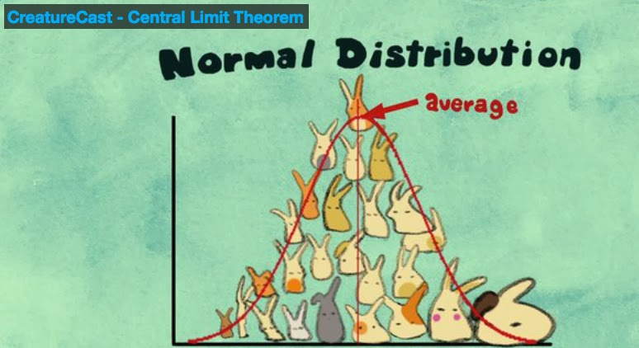
Central limit theorem allows us to estimate the variation of the location of the distribution
The sampling distribution of the mean approaches a normal distribution as the size of the sample increases, regardless of the shape of the original population distribution
Notes:
The central limit theorem states that the sampling distribution of the mean of any independent, random variable will be normal or nearly normal, if the sample size is large enough.
More about it: https://corporatefinanceinstitute.com/resources/knowledge/other/central-limit-theorem/

Slide 31
Two conclusions from the data
Conclusion 1: The difference is interesting, biologically meaningful – PI happy, start writing manuscript, plan further experiments.
Conclusion 2: Skeptical viewpoint, there is no difference, or unable to conclude that there is one – back to the drawing board.
All statistical hypothesis testing is based on the latter the skeptical viewpoint
How can we establish which of these alternatives has the higher probability of being true?
Hypothesis Testing workshop - Reuben Thomas
Notes:
More information: https://uca.edu/psychology/files/2013/08/Ch10-Experimental-Design_Statistical-Analysis-of-Data.pdf

Slide 32
Theoretical distribution of difference in means under the skeptical view-point/Null hypothesis
H0 No differences – TRUE
Reject H0 – wrong decision
Type I error and p-value
Your findings are significant when in fact they have occurred by chance - FP
Notes:
A sampling distribution is a theoretical probability distribution of the possible values of some sample statistic that would occur if we were to draw all possible samples of a fixed size from a given population

Slide 33
Alter the number of replicates
n=4
n=3
n=15

Slide 34
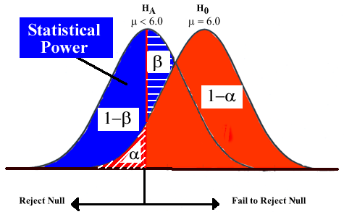
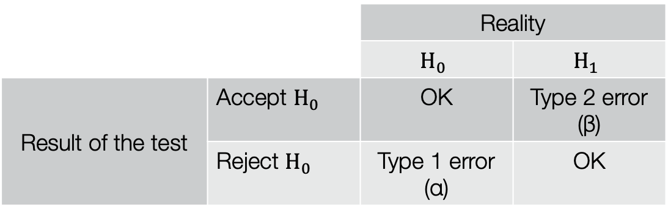
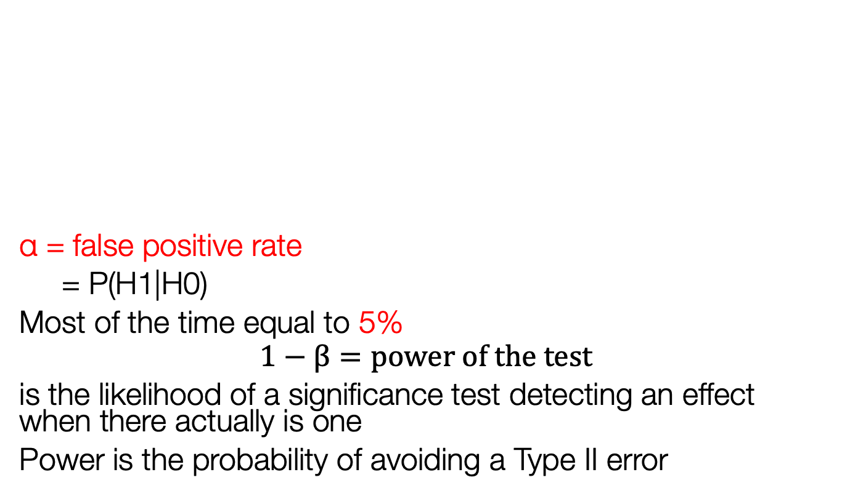
Test errors
α = false positive rate
= P(H1|H0)
Most of the time equal to 5%
$$1−β=power of the test$$
is the likelihood of a significance test detecting an effect when there actually is one
Power is the probability of avoiding a Type II error
 |  | Reality
 |  | $$H_{0}$$ | $$H_{1}$$
Result of the test | Accept $H_{0}$ | OK | Type 2 error (β)
 | Reject $H_{0}$ | Type 1 error (α) | OK

Slide 35
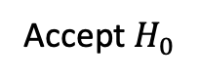
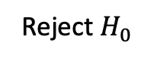
P-value
P-value = probability that the result (significance) is only due to chance
P-value = Probability of incorrectly rejecting the null hypothesis, given that it’s true (false positive).
Compared to α rate chosen
α = 5%
P-value
Reject $H_{0}$
Accept $H_{0}$

Slide 36
Testing for differences in expression of multiple genes

Slide 37
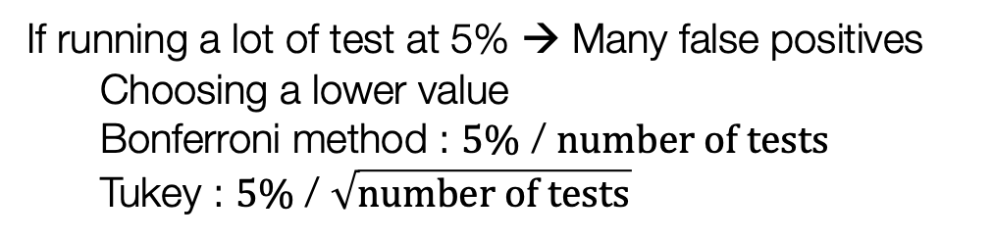
Look at distribution of p-values
No real differences
Possible differences
Multiple testing procedures
If running a lot of test at 5% → Many false positives
Choosing a lower value
Bonferroni method : $5\%$ / $number of tests$
Tukey : $5\%$ / $\sqrt{number of tests}$
Notes:
More about multiple testing correction:
https://towardsdatascience.com/an-overview-of-methods-to-address-the-multiple-comparison-problem-310427b3ba92

Slide 38
Break ~ 5 minutes
For more details and questions:
michela.traglia@gladstone.ucsf.edu
reuben.thomas@Gladstone.ucsf.edu
Please take the survey:
https://www.surveymonkey.com/r/F75J6VZ

Slide 39
Outline
Experimental design principles
Types of analytical studies
Independent variable / response variable
Target population and generalization
Statistical principles
Experiment: Assess differences between gene expression at two developmental stages
Aggregation and inter-comparison
P-value and multiple test correction
Biological and technical replicates
Power and sample size
Overview statistical tests based on response and predictor
Confounding factors
Good vs bad experimental design

Slide 40
Replicates
How large differences are you looking for?
What is the expected expression difference of targeted biology in these samples?
Will ”no change” be a desired significant result?
Biological vs technical replicates
Number of replicate runs that will give a high probability of detecting an effect of practical importance
Use biological replicates to answer biological questions, and technical replicates to answer technical questions
Notes:
Learn more about replicates and repeats:https://support.minitab.com/en-us/minitab/18/help-and-how-to/modeling-statistics/doe/supporting-topics/basics/replicates-and-repeats-in-designed-experiments/

Slide 41
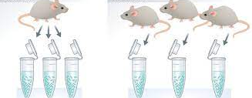
Poll
A
B
Cell cultures have originated from one mouse (Exp A) and from 3 mice (Exp B). What do you have in experiment B?
3 technical replicates
3 biological replicates

Slide 42
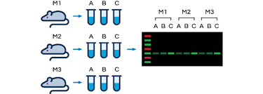
Biological vs technical replicates

Slide 43
Effect size and power
Sample size -> amount of information -> precision (margin of error) / level of confidence in our sample estimates.
High variability -> Greater uncertainty
Larger sample size -> more information -> less uncertainty
Power – probability that we find statistically significant evidence of a difference between the groups, given that there is a difference in the population.
Effect size is the estimated difference between the groups that we observe in our sample
Small effect size -> large sample size to detect the difference OR effect masked by the randomness
Notes:
https://select-statistics.co.uk/blog/importance-effect-sample-size/
Confidence interval:
The ${CI}_{95\%}\text{has} 95\%$ of chance to contain the true value of the parameter
In term of the mean, the standard deviation, and the sample size
${CI}_{95\%}=$[$\overline{X_{n}}−1.96\frac{s}{\sqrt{n}};\overline{X_{n}}+1.96\frac{s}{\sqrt{n}}\text{]}$
Example of use:
CI=[-5,-2] → The value is negative
CI=[-5,5] → Not significant

Slide 44
Is a larger sample sizes always better?
+ Greater precision and power
- Cost more time and money
The goal is to collect enough data from a sample to statistically test whether you can reasonably reject the null hypothesis in favor of the alternative hypothesis
Perform a sample size calculation before – acceptable power >0.8
If there are true effects to be found in 100 different studies with 80% power, only 80 out of 100 statistical tests will actually detect them

Slide 45
How many n?
Identify parameters of interest given experimental design – two variables models to more complex multivariate designs
Test statistic for the parameters of interest
Decide on the number of samples (to be drawn from the population of samples) under each setting
Estimates n of variation and correlation between variables of interest – use pilot data or publicly available data
Sampling distribution of this test statistic
Check assumptions for the validity of the sampling distributions

Slide 46
Z/T-statistic
Notes:
More at : https://blog.minitab.com/en/adventures-in-statistics-2/understanding-t-tests-t-values-and-t-distributions
T-values are an example of what statisticians call test statistics. A test statistic is a standardized value that is calculated from sample data during a hypothesis test.
The procedure that calculates the test statistic compares your data to what is expected under the null hypothesis.
Each type of t-test uses a specific procedure to boil all of your sample data down to one value, the t-value
The calculations behind t-values compare your sample mean(s) to the null hypothesis and incorporates both the sample size and the variability in the data.
A t-value of 0 indicates that the sample results exactly equal the null hypothesis. As the difference between the sample data and the null hypothesis increases, the absolute value of the t-value increases.

Slide 47
T-statistic and sampling distribution
T-distributions assume that you draw repeated random samples from a population where the null hypothesis is true.
t-value from your study in the t-distribution to determine how consistent your results are with the null hypothesis.
Notes:
More at : https://blog.minitab.com/en/adventures-in-statistics-2/understanding-t-tests-t-values-and-t-distributions
A sampling distribution is a theoretical probability distribution of the possible values of some sample statistic that would occur if we were to draw all possible samples of a fixed size from a given population
If we drew multiple random samples of the same size from the same population and performed the same t-test, we would obtain many t-values and we could plot a distribution of all of them. This type of distribution is known as a sampling distribution.
We don’t need to collect many samples to do this but different t-distributions exist for every sample size!

Slide 48
Outline
Experimental design principles
Types of analytical studies
Independent variable / response variable
Target population and generalization
Statistical principles
Experiment: Assess differences between gene expression at two developmental stages
Aggregation and inter-comparison
P-value and multiple test correction
Biological and technical replicates
Power and sample size
Overview statistical tests based on response and predictor
Confounding factors
Good vs bad experimental design

Slide 49
Continuous response and categorical predictor
Three unrelated groups
Differences among means
Y: gene expression
X: development time
One-way ANOVA – F-statistics
Notes:
To use the F-test to determine whether group means are equal, it’s just a matter of including the correct variances in the ratio. In one-way ANOVA, the F-statistic is this ratio:
F = variation between sample means / variation within the samples
For one-way ANOVA, the ratio of the between-group variability to the within-group variability follows an F-distribution when the null hypothesis is true.
A two-way ANOVA is used to estimate how the mean of a quantitative variable changes according to the levels of two categorical variables. Use a two-way ANOVA when you want to know how two independent variables, in combination, affect a dependent variable( more here: https://www.scribbr.com/statistics/two-way-anova/)

Slide 50
Two categorical variables
 | In TGF-b signaling pathway | Not in TGF-b signaling pathway
Differentially expressed | 20 | 980
Not differential expressed | 80 | 18920
Y1: gene differentially expressed or not
Y2: gene in TGF-b signaling pathway or not
Odds ratio, Chi-square statistics
The chi-squared test works by calculating the frequencies we would expect to see in the cells if there were absolutely no association

Slide 51
Continuous response against a continuous variable
Associate multiple (noisy) factors with each other
Y: Child’s height
X: Parent’s height
Slope, linear regression

Slide 52
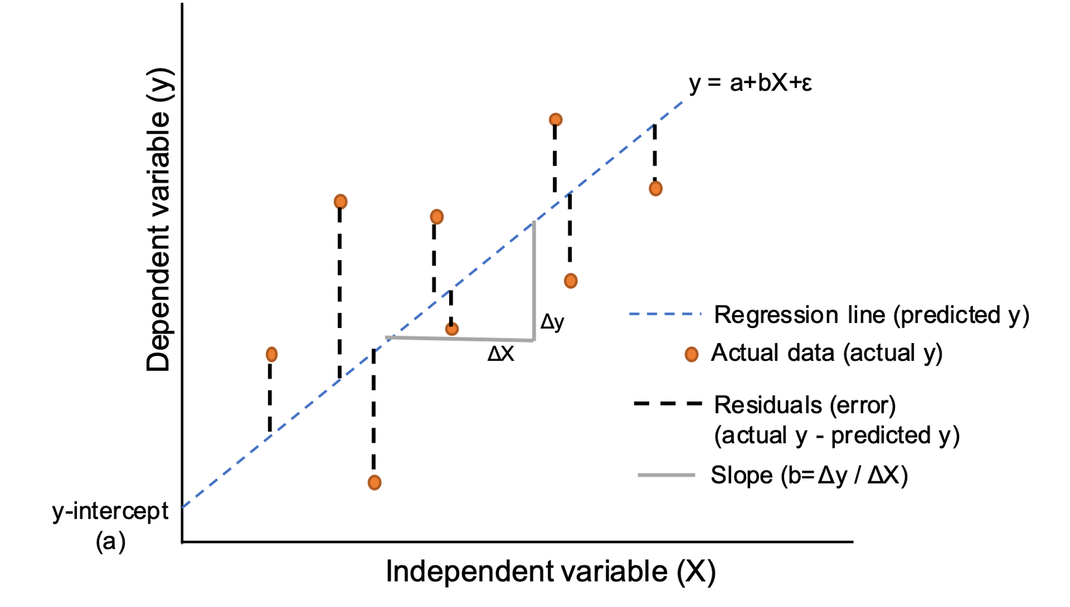
Residual: Variation left over after we have captured the known effects
Full model
Mean model
lm ( Y ~ condition)
lm ( Y ~ 1)
Residual: Predicted - Observed

Slide 53
Outline
Experimental design principles
Types of analytical studies
Independent variable / response variable
Target population and generalization
Statistical principles
Experiment: Assess differences between gene expression at two developmental stages
Aggregation and inter-comparison
P-value and multiple test correction
Biological and technical replicates
Power and sample size
Overview statistical tests based on response and predictor
Confounding factors
Good vs bad experimental design

Slide 54
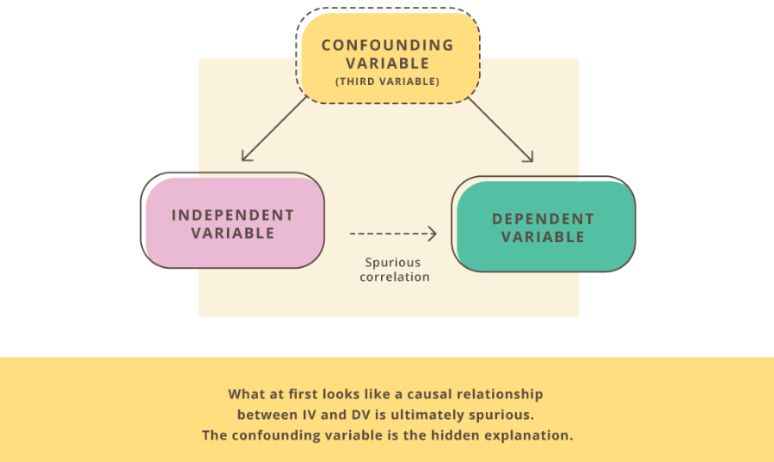
A third variable

Slide 55
Be aware of confounding factors
In observational studies (case-control, cohort studies):
lurking variables could cause unusual interpretations of data and the relationships between variables
In experimental studies:
- design the experiment to eliminate (as much as possible) the risk of lurking variables
Which potential variables could be affecting the relationship between the variables in your study?

Slide 56
Chemical in pregnant maternal blood correlating with healthy children
Mother with high levels of chemicals blood
Healthy kids
->
Correlation
High chemicals levels – not developing autism
Low chemicals levels – children developing autism
?
Genetics make-up controlling metabolism of chemical

Slide 57
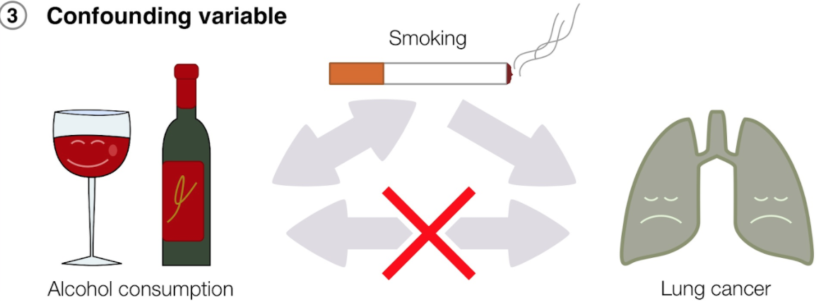
Correlation vs Causation

Slide 58
Poll
Research question: Does light exposure improve learning ability in mice?
What can be the source of variability, confounding the outcome?
Select all that apply
1. Mouse inbred strains
2. Genetic background
3. Learning environment
4. All are ‘independent variables’

Slide 59
Factors potentially affecting the response
Biological factors that could affect the response
-BMI
-gender
Non-biological or technical factors that could affect the response.
-time/day/month of experiment/batch
-reagents used, reagents batch used
-technician

Slide 60
Capture effects of interest and avoid unwanted variation in experiment
Identify the response and variables of interest
Identify target population that you want to base your claims on
Identify factors that affect the response of interest
Choose samples from target population
Randomly assign samples across different levels of factors affecting response
Block out variation that is not of interest by randomly assigning to levels of factors within a block

Slide 61
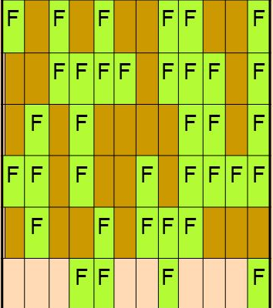
Randomization
Fisher -> helps to avoid confusion or biases due to changes in background or lurking variables.
One of the main purposes for experimental designs is to minimize the effect of experimental error.
Randomization, replication, and blocking, are methods of error control.

Slide 62
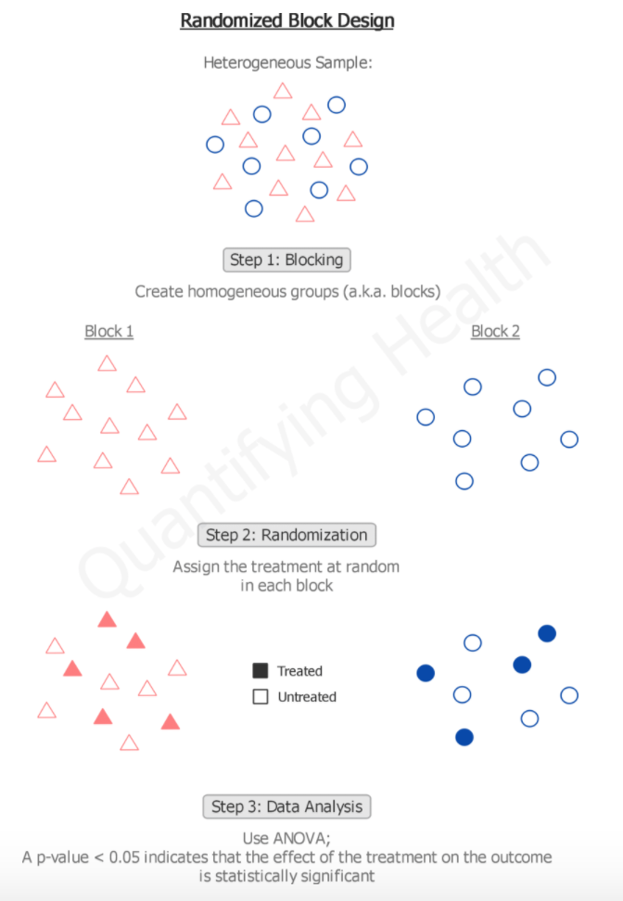
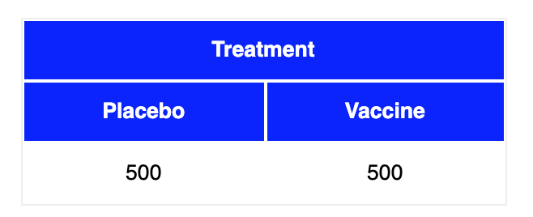
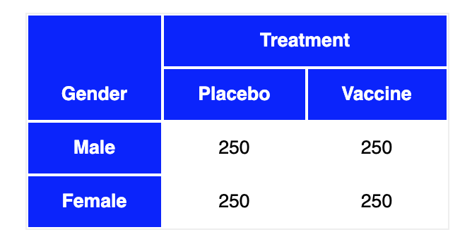
Randomized block design
https://quantifyinghealth.com/randomized-block-design/
https://stattrek.com/experiments/experimental-design.aspx

Slide 63
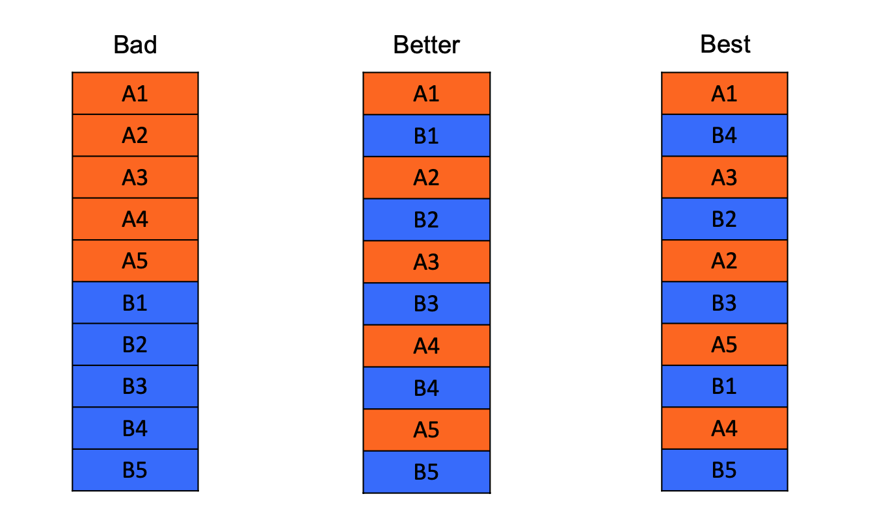
Good vs Bad experimental design
The default analysis assumes the data have come from a completely randomized design.
In practice, this is often a false assumption.
Solveig Mjelstad Olafsrud, Oslo University Hospital
Randomization
Notes:
https://www.fiosgenomics.com/experimental-design/
Control for systematic bias (error):
Distribute the biological groups systematically in a balanced fashion: for two groups of equal size, every second from each group
Divide it into roughly equal size batches limited by your capacity for the step
Tip: colour code the sample names by biological group and the column next to it by batch
Randomization and balancing with respect to biology of interest: Possible to separate technical variation from biological variation

Slide 64
Poll
 | Design 1 – Sample prep date | Design 2 – Sample prep date
Sample_1_E9.5 | Jan 9th, 2019 | Jan 11th, 2019
Sample_2_E9.5 | Jan 9th, 2019 | Jan 9th, 2019
Sample_3_E9.5 | Jan 9th, 2019 | Jan 11th, 2019
Sample_4_E9.5 | Jan 9th, 2019 | Jan 9th, 2019
Sample_1_E11.5 | Jan 11th, 2019 | Jan 11th, 2019
Sample_2_E11.5 | Jan 11th, 2019 | Jan 9th, 2019
Sample_3_E11.5 | Jan 11th, 2019 | Jan 11th, 2019
Sample_4_E11.5 | Jan 11th, 2019 | Jan 9th, 2019
Which is better design?
1) Design 1
2) Design 2

Slide 65
Poll
 | Design 1 – Gender | Design 2 - Gender
Sample_1_E9.5 | Male | Male
Sample_2_E9.5 | Male | Female
Sample_3_E9.5 | Male | Male
Sample_4_E9.5 | Male | Female
Sample_1_E11.5 | Female | Male
Sample_2_E11.5 | Female | Female
Sample_3_E11.5 | Female | Male
Sample_4_E11.5 | Female | Female
Which is better design?
Design 1
Design 2

Slide 66
Genotype and development time effect on gene expression

Slide 67
Litter effect dominates the variation

Slide 68
Confounding in scRNA-seq data is a big problem
Hicks, S. C., Townes, F. W., Teng, M. & Irizarry, R. A. Missing data and technical variability in single-cell
RNA-sequencing experiments. Preprint available from:https://doi.org/10.1093/biostatistics/kxx053 (2017).

Slide 69
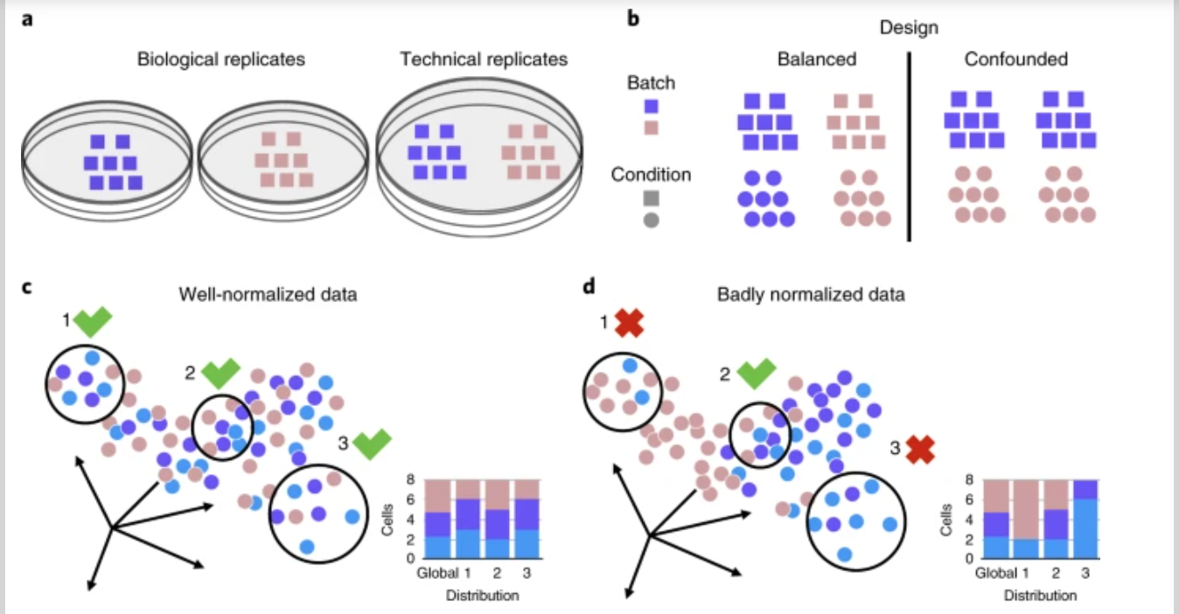
Well and badly analyzed scRNA-seq data
https://www.nature.com/articles/s41592-018-0254-1

Slide 70
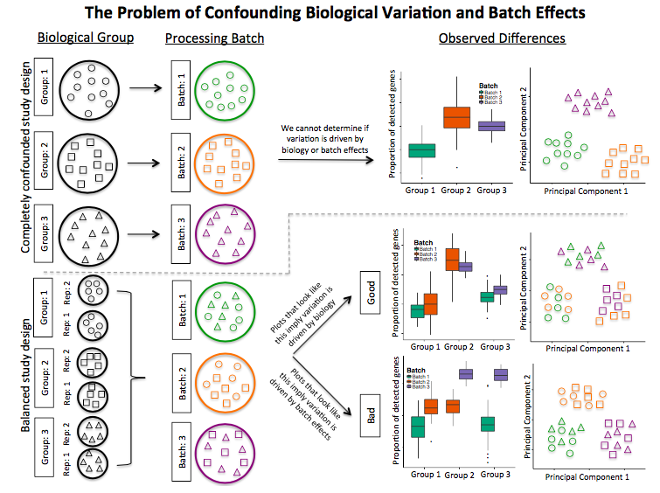
Confounding biological variation and batch effects

Slide 71
Experimental design allow you to:
(1) choose an experimental design that is appropriate for the research problem at hand
(2) construct the design (performing randomization and determining the number of replicates)
(3) execute the plan to collect the data (or advise a colleague on how to do it)
(4) determine the model appropriate for the data
(5) fit the model to the data
(6) interpret the data and present the results in a meaningful way to answer the research question

Slide 72
Take – home messages
Plan ahead
Prevent bias from uncontrollable
Randomization and balancing
Write it down in an Experimental plan
Follow the experimental plan
Be careful with interpretation of results!
Notes:
Suggested reading: Stephen M.. 2016. Seven Pillars of Statistical Wisdom. Harvard University Press

Slide 73
Upcoming workshop at Gladstone:
Fall series
December 3 | Intermediate R: Data Visualization
December 6-7 | Intermediate RNA-Seq analysis Using R
Data Science Training Program
Please visit the link before spring 2022 for new workshops

Slide 74
For questions:
michela.traglia@gladstone.ucsf.edu
reuben.thomas@Gladstone.ucsf.edu
Thank you!
Please take the survey:
https://www.surveymonkey.com/r/F75J6VZ

Slide 75
Additional resources

Slide 76
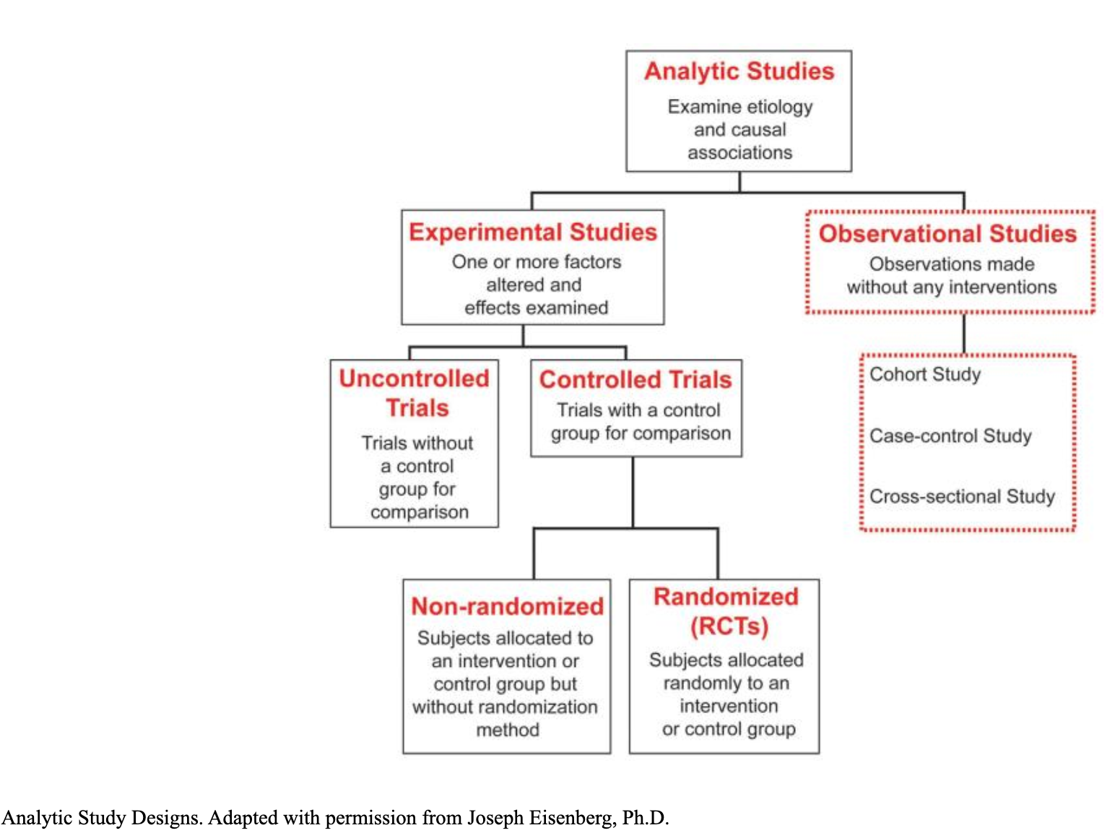
Observational vs Experimental studies

Slide 77
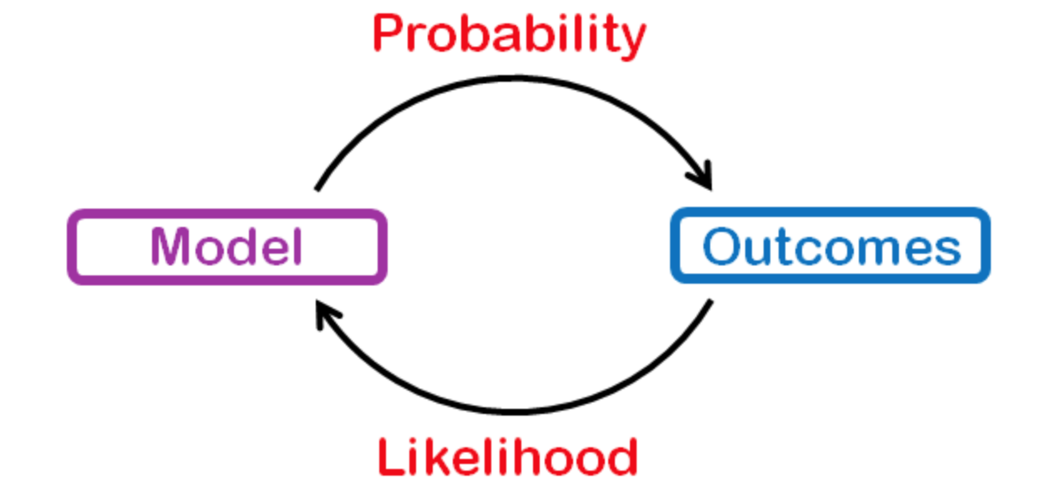
Probability and likelihood
the model parameters are known and the data/outcome has to be found.
the data/outcome is known and the model parameters have to be found.
Probability is used to finding the chance of occurrence of a particular situation, whereas Likelihood is used to generally maximizing the chances of a particular situation to occur.
Notes:
Probability refers to finding the chance that a particular event occurs given a distribution of the data or some conditions/evidence. Probability is the percentage that an event will occur, it talks about the future and it’s written as P(Hypothesis|Evidence).
In Likelihood, we try to fit a distribution to data. It talks about the past as the event had been already happened. It can be written as P(Evidence|Hypothesis).
https://medium.com/analytics-vidhya/probability-vs-likelihood-873dcfe15df8

Slide 78
Probability density and cumulative distribution
Density
Distribution
Notes:
The probability density function (PDF) is the probability that a random variable, say X, will take a value exactly equal to x.
The cumulative distribution function (CDF) is the probability that a random variable, say X, will take a value less than or equal to x.
For the cumulative distribution function, we are interested in the probability taking on a value equal to or less than the specified value

Slide 79
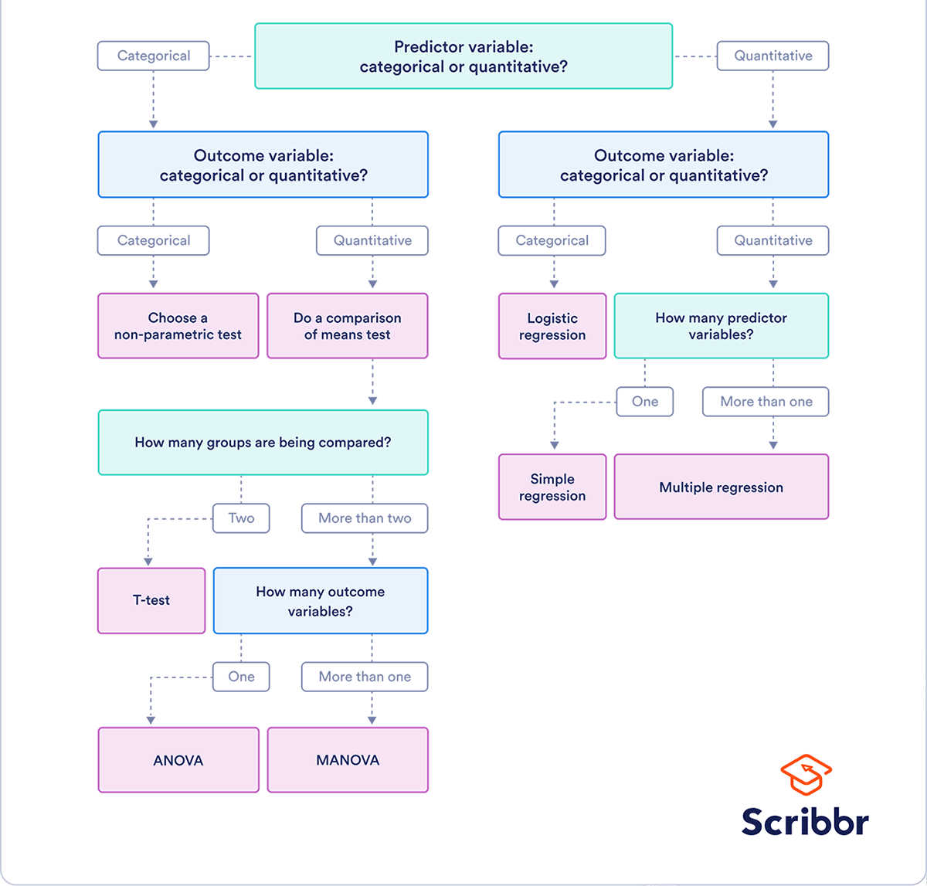
How to choose the right statistical test?

